Slide 1

CSE488: Big Data Analytics
Lecture 2: Distributed File Systems
Dr. Mohammad Rezwanul Huq
Associate Professor
East West University

Slide 2
Single Node Architecture
CPU
Machine Learning
Statistical Computation
Memory
Data fits in main memory

Slide 3
Single Node Architecture (cont’d)
CPU
“Classical” Data Mining (batch processing)
Memory
Even batch processing is not sufficient sometimes!
Disk
Data doesn’t fit in main memory

Slide 4
Motivation: Google Example
10 billion web pages
Average size of webpage = 20KB
Total size = 10 billion * 20KB = 200 TB
Using classical computational model
  Problem is Bandwidth!
Disk read bandwidth = 50MB/sec
Total time to read = ???
Awfully long time!
Need multiple CPUs → Cluster Computing

Slide 5
Cluster Architecture
Backbone Switch
2-10 Gbps backbone switch
Gigabit Switch
Gigabit Switch
CPU
CPU
CPU
CPU
Memory
Memory
Memory
Memory
Disk
Disk
Disk
Disk
Each rack contains 16-64 commodity Linux nodes

Slide 6
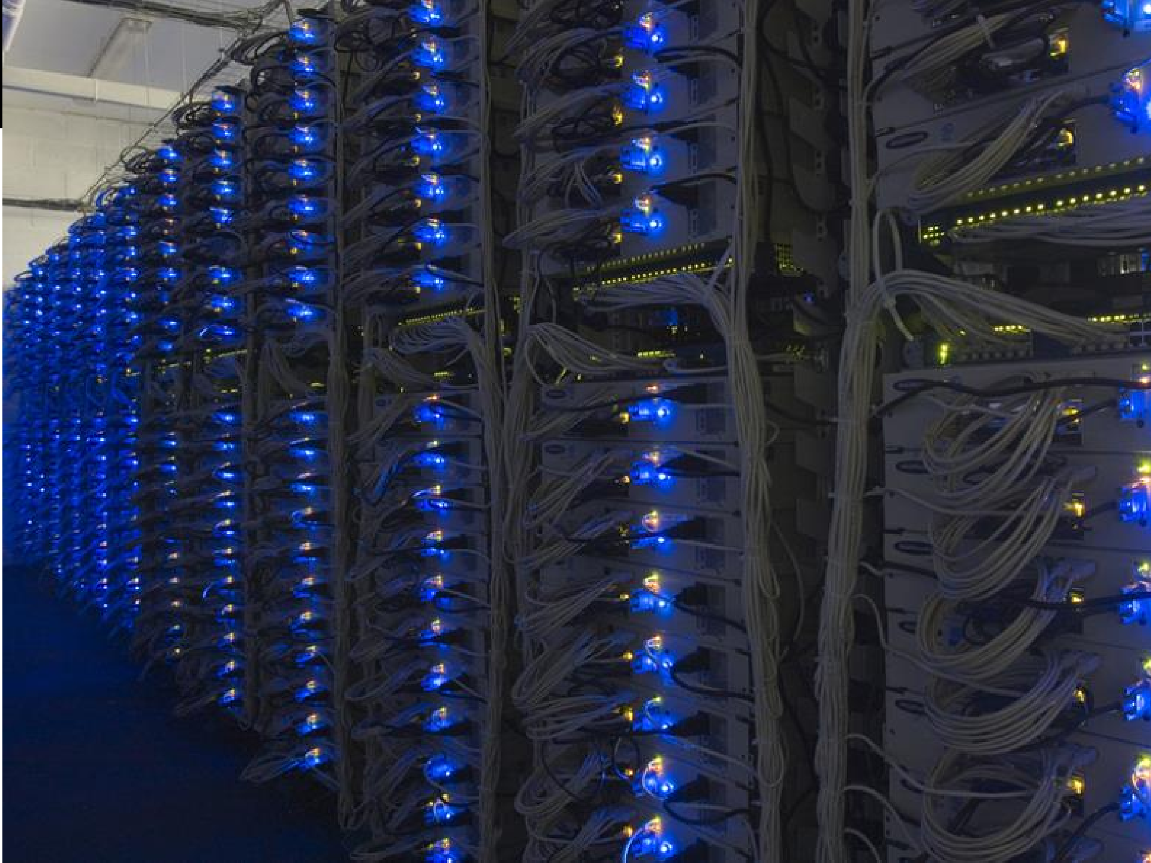
Data Center
Jure Leskovec, Stanford CS246: Mining Massive Datasets, http://cs246.stanford.edu

Slide 7
Cluster Computing Challenges (1)
Node Failures
  A single server can stay up for 3 years (1000 days)
  1000 servers in a cluster → 1 failure/day
  1M servers in a cluster → 1000 failures/day
How to store data persistently and keep it available if nodes can fail?
How to deal with node failures during a long-running computation?

Slide 8
Cluster Computing Challenges (2)
Network Bottleneck
  Network bandwidth = 1 Gbps
  Moving 10TB of data takes days to transfer
  Need a framework that doesn’t move data
Distributed Programming is challenging!
  Need a simple model that hides most of the complexity

Slide 9
An idea and solution
Idea:
  Store files multiple times for reliability
  Bring computation to data
  Simple programming model to hide all complexities
Spark/Hadoop address these problems
  Storage Infrastructure – Distributed File system
    Google: GFS. Hadoop: HDFS
  Programming model
    MapReduce
    Spark

Slide 10
Redundant Storage Infrastructure
Problem:
  If nodes fail, how to store data persistently?
Answer:
  Distributed File System
    A file system that stores data across a cluster but stores each piece of data multiple times.
    Provides global file namespace, redundancy and availability
    Google GFS (proprietary) , Hadoop HDFS (open-source)
  Typical usage pattern
    Huge files (100s of GB to TB)
    WORM (write once, read many); appends are possible

Slide 11

Distributed File System
Data kept in “chunks” spread across machines
Each chunk replicated on different machines
  Seamless recovery from disk or machine failure
  Ensures persistency and availability
C0
C1
D0
C1
C2
C4
C0
C4
…
C5
C2
C5
C3
D0
D1
D1
C3
Chunk server 1
Chunk server 2
Chunk server 3
Chunk server N
Bring computation directly to the data!
Chunk servers also serve as compute servers

Slide 12
Distributed File System
Chunk servers
  File is split into contiguous chunks
  Typically each chunk is 16-64MB
  Each chunk replicated (usually 2x or 3x)
  Try to keep replicas in different racks
Master node
  a.k.a. Name Node in Hadoop’s HDFS
  Stores metadata about where files are stored
  Might be replicated
Client library for file access
  Talks to master to find chunk servers
  Connects directly to chunk servers to access data

